Slide 1

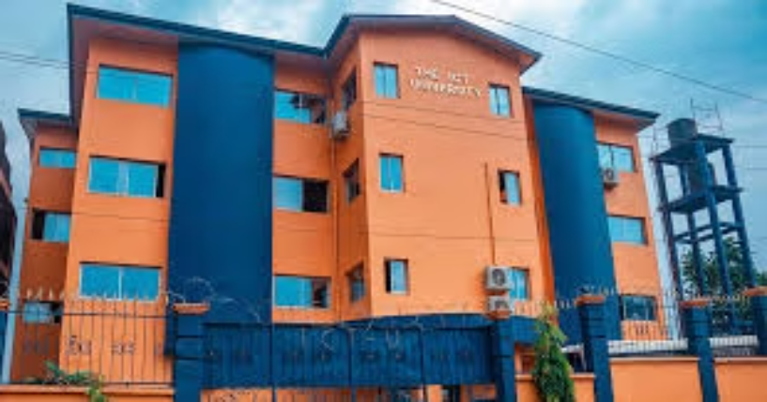
ICT University Canteen
Revitalization Project
Welcome to the ICT University. This presentation outlines our comprehensive plan to transform the canteen experience for students and staff.

Slide 2

About the School…
ICT University
Canteen History
Challenges
A leading educational institution committed to excellence in technology and innovation. ICT University boasts a diverse student body and a dedicated faculty.
The current canteen has been operational for several years. It serves as a central hub for students and staff to gather and enjoy meals.
The current canteen faces challenges including limited seating, outdated facilities, and a lack of diverse food options.

Slide 3





Group Details
Group 5
Project Goals
We are a passionate team of students dedicated to improving the canteen experience for the ICT University community.
Our project aims to create a modern, welcoming, and functional canteen that meets the diverse needs of the university community.
Mission
Vision
Improve the functionality, aesthetics and culinary offering of the canteen, by providing added value in the organization of orders, promoting a positive and pleasant experience.
Create a dynamic canteen space so that information is available to everyone and that students and staff are fully satisfied.

Slide 4

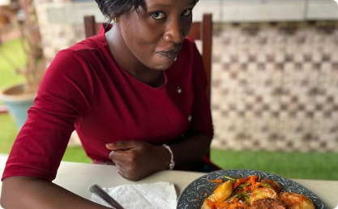
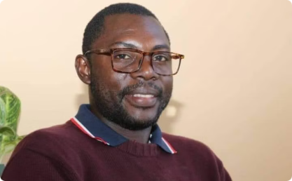


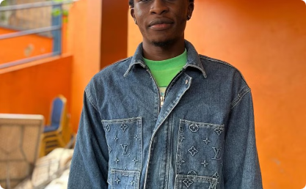
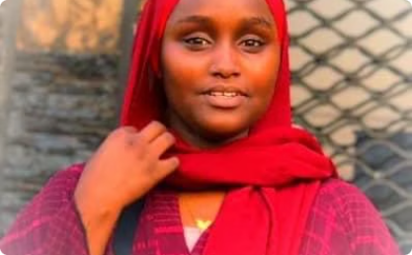

Team Members
Finamou Abdoul Belle-Grace
Ondoa Ondoa Etienne Materne
Kisso Eskil Hadar
Tah Bunikih Favour
Groupe Leader & Back-END Developper.
Design, Marketing backend and Photographer.
Frontend developer
System architecture and readme designer.
Nyanyoh Nyang Mark Okey
Haoua Matari
Mbab Mbaku Jerry
Creator of the groupe and initiator of the idea.
Report the project and Working on backend
Front end developer.

Slide 5
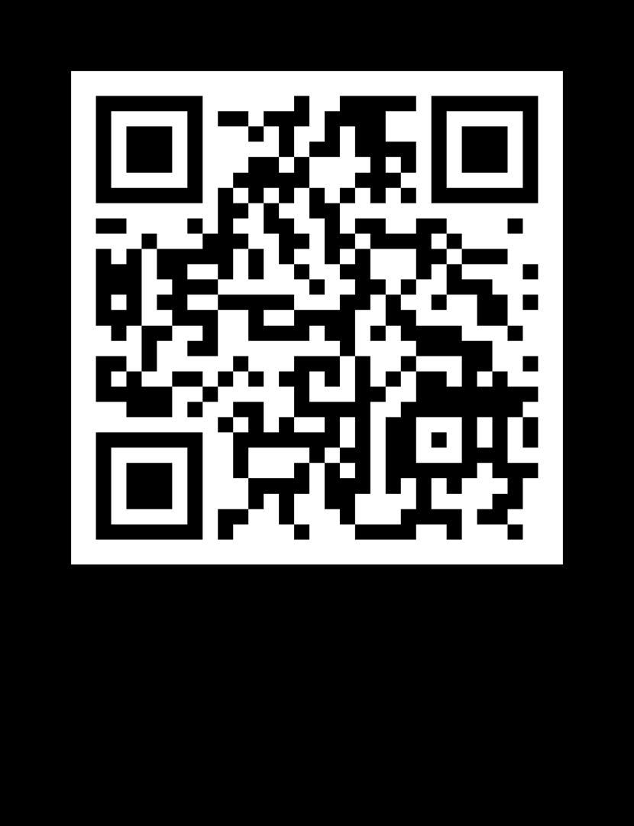
ICT University Canteen Website
Scan this QR code to access the ICT University Canteen website.

Slide 6

Challenges Faced in the Current Canteen System
Lack of Transparency
1
The current system lacks transparency, making it difficult for students to know the daily menu before arriving at the canteen. This lack of information leads to uncertainty and inconvenience.
2
Limited Communication
There is limited communication regarding menu changes, availability, or special events. This lack of communication leads to frustration and inconvenience for students and staff.
Lack of Diverse Food Options
3
The current menu is limited in its variety, failing to cater to the diverse dietary needs and preferences of the student and staff community.

Slide 7

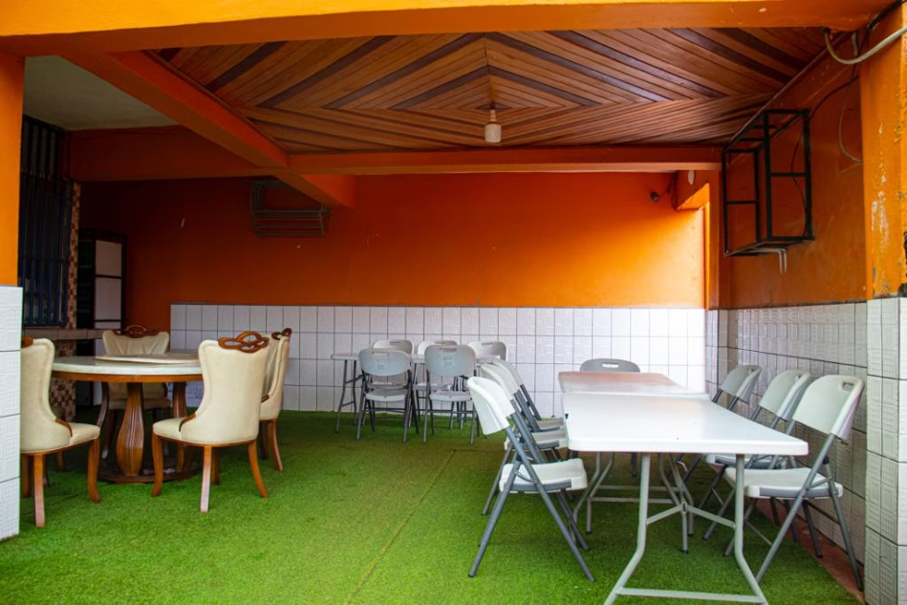
Canteen Improvement Goals
Enhanced Functionality
Technology Integration
Students and staff will be able to make suggestions regarding the menu as well as give their opinion on the quality of the food.
Implement a digital ordering system and online menu access for convenience and efficiency.

Slide 8


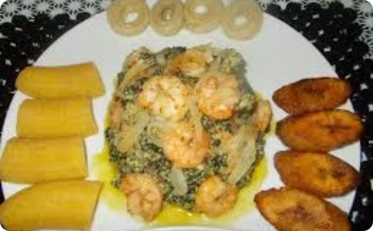
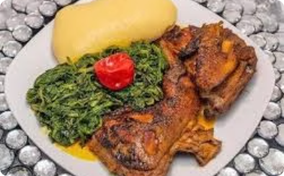
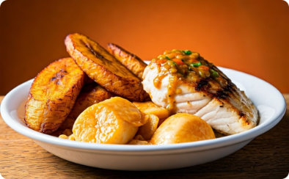
Some Local meals of our Canteen
Eru Soup with Fufu
NDOLe with plantain and Miondo
Kati Kati
Fried Plantain with Chicken or Fish

Slide 9

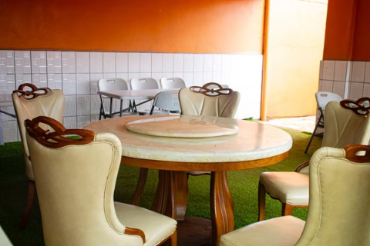
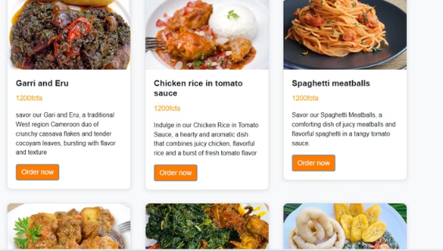


Enhancing the Student and Staff Experience
Improved Food Quality
The introduction of local Cameroonian cuisine will provide students and staff with delicious and authentic food options.
Enhanced Convenience
A digital ordering system will streamline the ordering and payment process, saving time and effort.

Slide 10
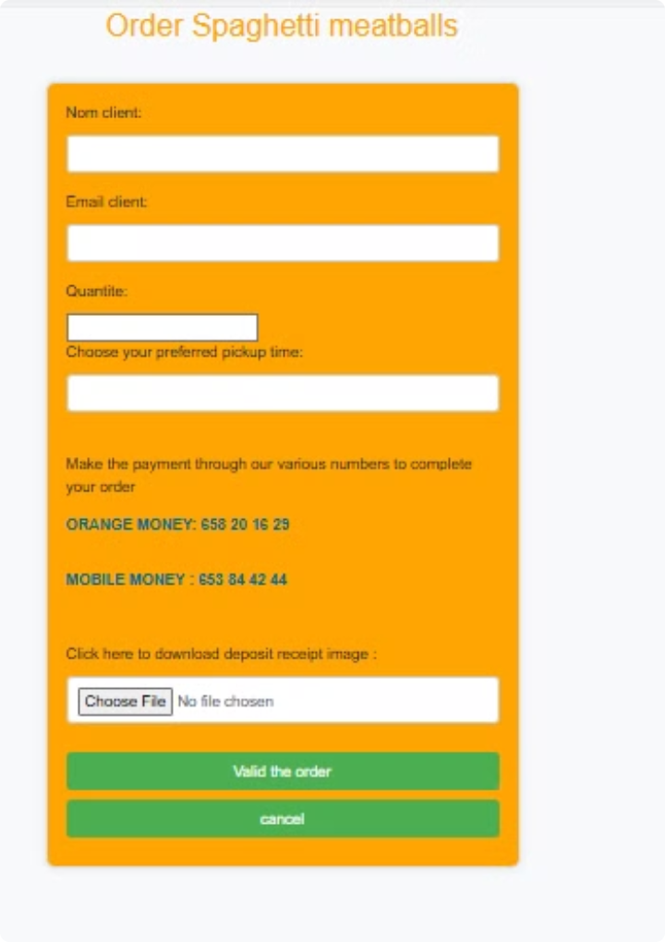
Allowing Food Reservation
Pre-ordering meals will enhance convenience for students and staff. A reservation system will streamline the ordering process, eliminating queues and waiting times. This feature allows users to select their desired meals in advance, specifying their preferred pick-up time.

Slide 11


Next Steps and Timeline
Communication and Engagement
Maintain open communication with students and staff throughout the project, providing regular updates and addressing any concerns.

Slide 12

A Brighter Future for Our Canteen
We are confident that this revitalization project will create a more vibrant and welcoming space for our students and staff. With the implementation of a new digital ordering system, improved food quality, and increased transparency in menu planning, the canteen will offer a more efficient, convenient, and satisfying experience for everyone. We look forward to a successful transformation of the canteen, where students and staff can gather, connect, and enjoy delicious meals in a welcoming environment.

